Slide 1
Back to School Night
Second Grade

Slide 2
Availability
Notes from home
Friday Folder
Email: aholmes@stconstanceschool.org
Seesaw: https://web.seesaw.me/

Slide 3
Class Announcements
Class website: http://secondgrade102.weebly.com/
Seesaw
Email

Slide 4
Weekly Procedures
Daily planner: Students copy down homework written on the board every morning in their planner. Planner’s are checked at the end of the day before students go home
Weekly folders: work that needs to return to school the next day goes in the “return to school side of the folder”. Work that can stay at home goes in the “keep at home side of the folder”.
Homework: Homework is due the next day unless otherwise announced.
Friday folders: Graded tests and homework will be returned to student at the end of the week in their Friday folder. Students must return folders the following week with a parent or guardian signature.

Slide 5
Classroom Rules
Wear your mask
Follow Directions
Keep Your Hands to Yourself
Stay in Your Seats and Raise Your Hand
Work Quietly
Always Try!

Slide 6
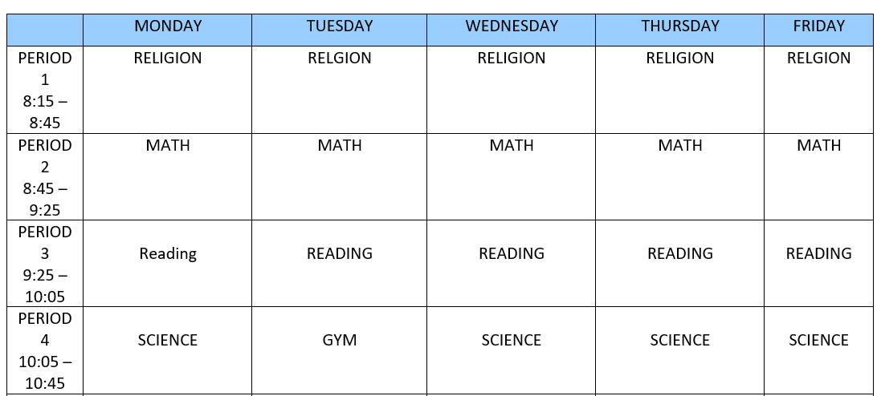
Morning Classes

Slide 7
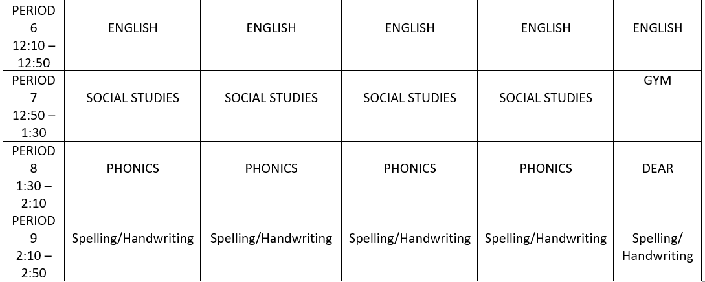
Afternoon Schedule

Slide 8
Curriculum
Religion: focusing on reconciliation and holy communion. Parent meetings to be announced.
Math: Focusing on adding and subtracting, place value, and measurement. Introduction to multiplication.
Reading: Reading fluency, story comprehension, becoming an independent reader
Science: Life science, physical science, earth science, human body, scientific method
Computers: Internet safety, ixl practice, information literacy, information literacy

Slide 9
Curriculum
English: Grammar skills and introduction to writing skills
Phonics: Consonants and vowel sounds
Social Studies: Geography, history,
Spelling: Weekly tests
Handwriting: Manuscript and cursive

Slide 10
Iready
Please watch the following video to learn about iready:
https://www.curriculumassociates.com/teaching-learning-2020/home-assessment-family-support?utm_campaign=IRE-656408b-NATL-200828-Assessing%20At%20Home%20Materials-Teacher-ptxt&utm_medium=email&utm_source=Eloqua

